Slide 1
DIAS: Decentralized Internet Applications and Services
Midterm Presentation
3/13/14
Adriana Flores
Clayton Shepard
Ellis Giles
Haiuhua Shen
Yanda Lu
Notes:
Today for Midterm presentation we are going to present our project DIAS
Our group is conformed by:

Slide 2
Agenda
Background & Motivation
DIAS Overview
Related Work
DIAS Framework
Progress
Remaining Work
Demo
Notes:
For our agenda today

Slide 3
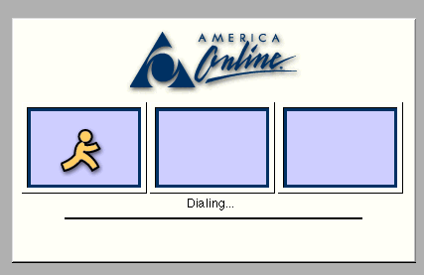
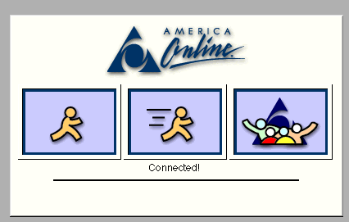

Motivation - Before
Rare users have persistent always-on connections.
Always connected servers used as intermediaries
Notes:
We all remember how we used to connect to the internet
It was rare for users to have…
Because we were not always on… Servers were our intermediaries that were allways on and help serve our communication even when we were offline

Slide 4
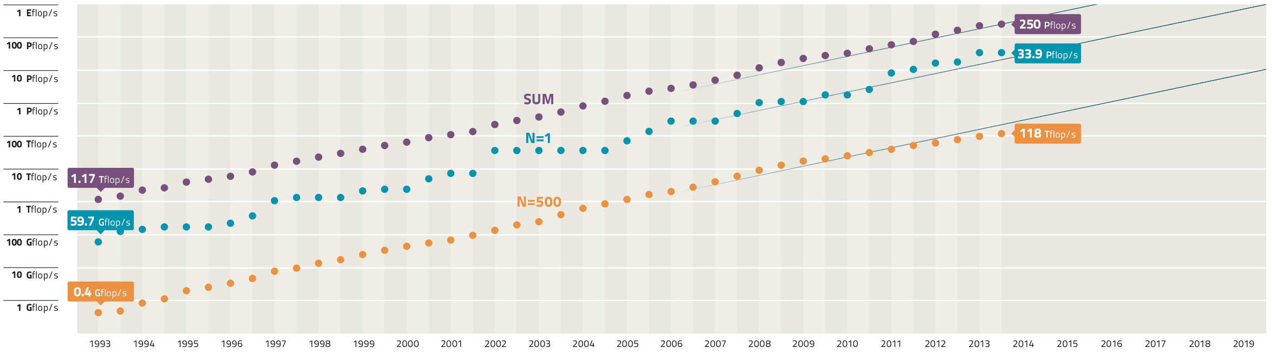
Motivation - Today
52Gflop/s
Mobile devices:
Widely adopted
Always-on
Always connected
Powerful Mobile Devices
Galaxy S4 - as powerful as a year 2000 super computer
Why do we still rely on servers?
Notes:
However,
Today:
Mobile devices are widely adopted
Always on
Always connected
--
On top of that… devices have gotten really powerful
For example
-Today’s phones e.g. galaxy s4 51 G flops = super computer in 2000
The question is…..
Why do we still rely on servers, if our phones are as powerful as supercomputers
no technological reason that devices can’t connect directly to one another
Increase in # devices
Wireless network more and more available.
Smart phone widely adopted with wireless data.

Slide 5
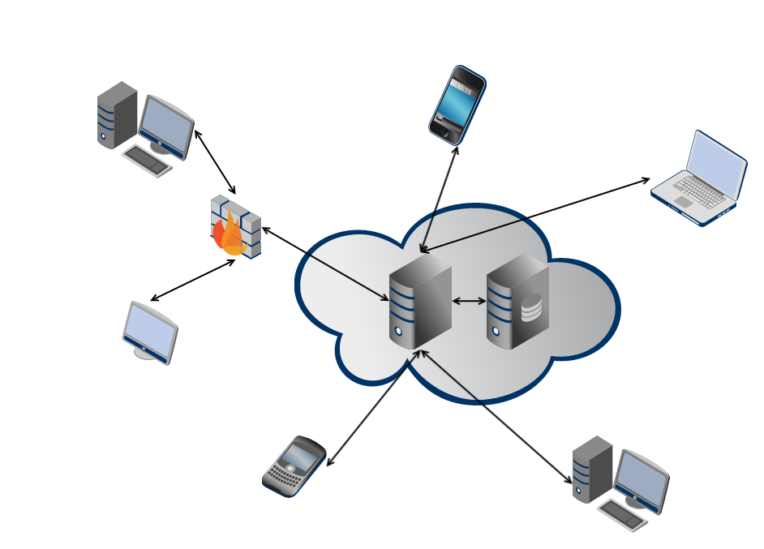
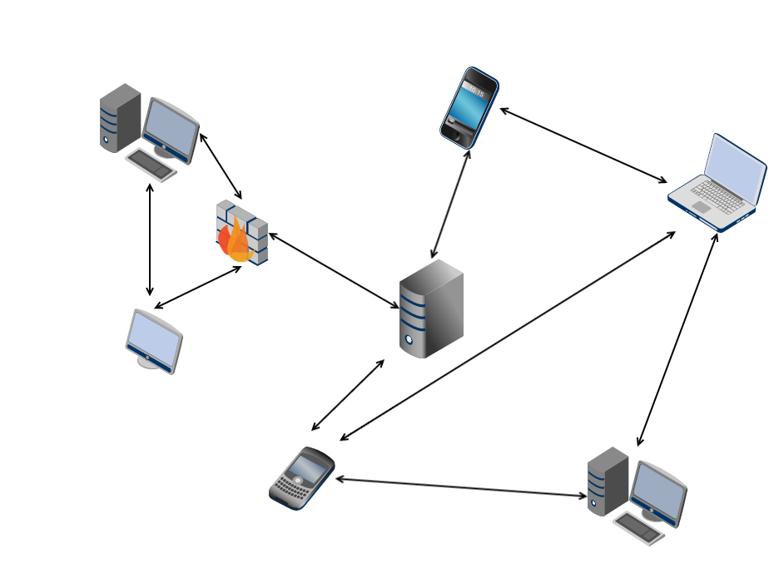
DIAS: Decentralized Internet Applications and Services
Centralized Architecture
Single point of failure
✗ Privacy
✗ Security
✗ Energy efficiency
Decentralized Architecture
Robust to failure
Reclaim personal data
Power efficiency
Notes:
centralized servers have many drawbacks, ranging from
privacy, security, and fault-tolerance, to even energy-efficiency
and control over data
Power-hungry data centers
According to Google their global data center operation electrical power ranges between 500 and 681 megawatts.
Decentralize the current server-client mode paradigm in the current Internet

Slide 6
DIAS Overview
Goal:
Decentralize the current server-client model
Replace servers with point to point communication for personal communication and services
Email, Web Pages, Social Networking, Chat, VoIP
Benefits:
Security, Privacy, Resilience, Cost, and Power
Challenges:
Redundancy, Uptime, Failover, Battery Management
Notes:
How do we ensure reachability?
What happens if the cellphone loses connectivity?
What if it is lost/broken/stolen?
We need to find novel methods to ensure redundancy for both uptime and data.
Redundancy
Uptime
Data

Slide 7
Related Work

Slide 8
Related Work
Peer to Peer Networks (P2P)
Connectivity and Reachability
Data Replication

Slide 9

Related Work – P2P
Bitcloud
Decentralizing the Internet, creating Distributed Applications, and developing a new mesh network to replace the Internet.
Improve privacy, security, and ending Internet censorship.

Slide 10
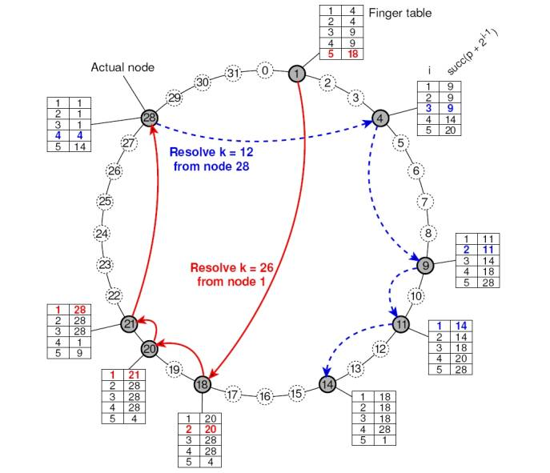
Related Work – P2P
Chord and Pastry
Peer-to-peer lookup service for Internet applications
Peers can join and leave

Slide 11
Related Work – Connectivity and Reachability
Most networks block reachability
Solutions
IPv6 with Mobile IP
Unmanaged Internet Architecture (UIA)
Largely solved issue
Caused by business policy, not technical challenge
Notes:
It is not enough for the device to have internet connectivity, but it must also be reachable from the internet.
Cell phone providers and WiFi access points hide their clients behind network address translation (NAT) or a firewall which blocks reachability from the internet.
UIA by MIT, solves the connectivity and reachability issue even in the current state of the internet, however it requires some assistance from devices with public IPs to enable NAT traversal.
[14] B. A. Ford, “Uia: a global connectivity architecture for mobile personal
devices,” Ph.D. dissertation, Massachusetts Institute of Technology,
2008.

Slide 12
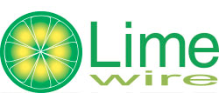
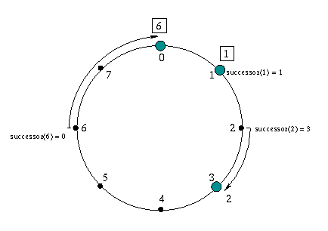
Related Work – Data Replication
Decentralized P2P ﬁle sharing programs - replicate ﬁle data on end nodes, which may become corrupt or suffer from loss of availability
Limewire
Bittorrent
Kazaa
PAST
Built on Pastry
Replicates files close to owner’s nodes
Replicates entire files
Notes:
Data replication in distributed systems, such as a Peer-To-Peer systems, where nodes are unreliable, additional considerations for the dynamic nature of nodes and data replication must be considered.

Slide 13
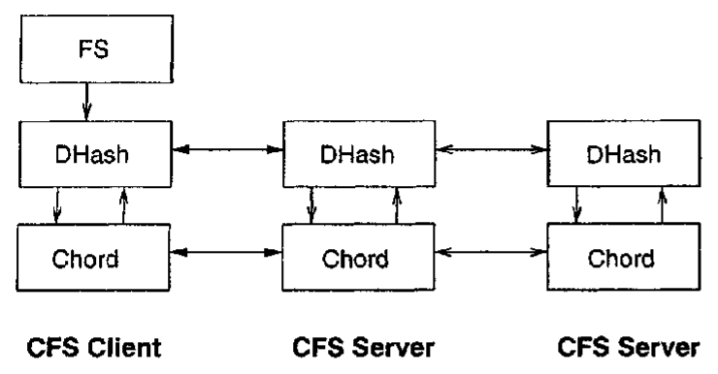
Related Work – Data Replication
Cooperative File System (CFS)
Peer-to-peer read-only storage system that provides provable guarantees for the efficiency, robustness, and load-balance of file storage and retrieval.
Built on Chord – Coordinated File System
Replicates files close to owner’s nodes
Replicates at block level to distribute the load and storage space among servers in the network.

Slide 14


Related Work – Data Replication
Content Delivery Networks
Replicate data near consumers.
Akamai
Amazon S3

Slide 15
DIAS Framework & Progress

Slide 16
DIAS Architecture
Building Blocks
Connectivity & Reachability
Naming and Domain Management
Integration
Android Application
Devices publically accessible
Basic Services
Full Communication
DNS
Failover
Web and Email services
Key Functionalities
Power Management
Data Replication
Smart Failover
Server Manager
Battery Power Monitoring

Slide 17
Building Blocks

Slide 18
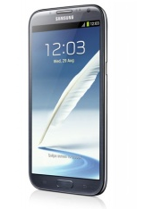
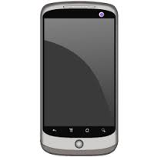


Reachability Problem
Internet
Client

Slide 19
Reachability Solution
VPN
Internet
Client

Slide 20
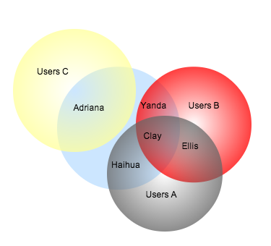
Naming and Management
DNS
Backwards Compatible
Human friendly names
Help with load balancing and failover
Identify our personal clusters
Self-own laptop, smartphone, desktop, tablet, etc.
Clever self failover technique
Establish a failover order self-own devices
Conventional DNS provides human friendly names as well as domain management, and, in
more advanced systems can also provide load-balancing and failover.
In our architecture we will additionally use it help specify our personal ”‘mini-clusters”’ and failover order.

Slide 21
Communication Services
Utilize open-source server software, provide basis for our communication services
Email Server
Web server
Other services
Guarantee:
99% uptime
Backwards compatibility
open-source server software, such as postfix, sendmail, apache,
etc., which will provide the basis of our communication ser-
vices.
full communication
and service, which are even backwards compatible with the
existing email and web services.

Slide 22
Integration

Slide 23
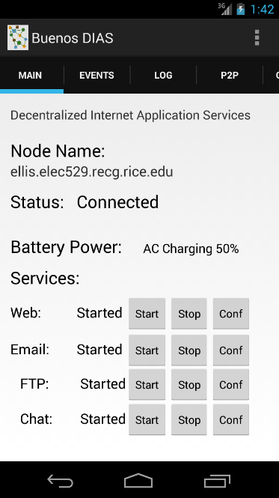
Android Application
Event and Debug Logs and Configuration Tabs
Configurable Node Name
Connection and Overall Status Monitoring Thread/Event Receiver
Battery Power Monitoring Thread and Event Broadcast Receiver
Can act on power changes.
Pluggable Services List
Services can provide Start, Stop, and Configuration methods.
Web, Email, FTP, etc.

Slide 24
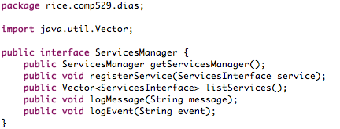
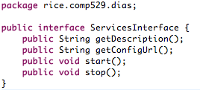



Web
Email
Other Services

Slide 25
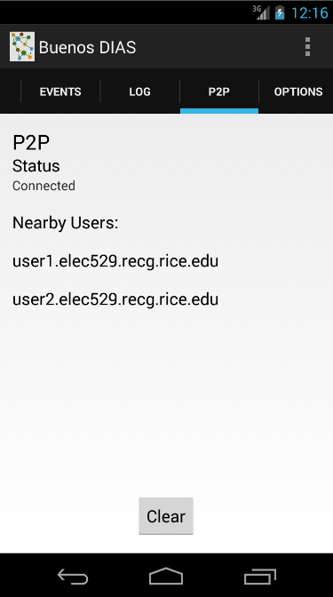
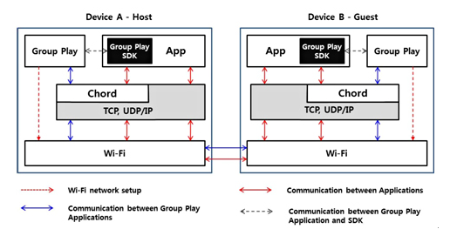
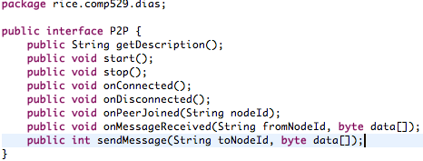
Samsung Group Play SDK Utilizes Chord
However, it is closed source and doesn’t execute outside of Android SDK. Chord SDK Discontinued
Facade
P2P Interface
Chord
Pastry
…

Slide 26
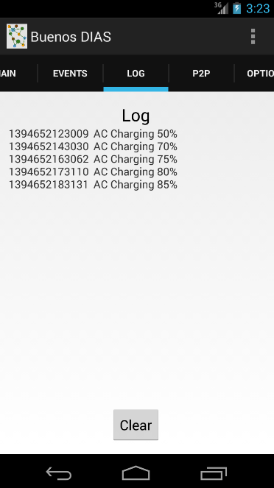
Battery Power Monitoring
Event Log for asynchronous events received from the device such as, network and battery levels. It also logs events for pluggable services and building blocks.
Debug Log contains debug messages from monitoring threads and services.
Android application can react to changes in the battery level or network events.
It has monitoring threads for battery and network connections, and depending on thresholds, the application will be able to react and shutdown services or send notification messages.

Slide 27
Progress
Building Blocks
Connectivity & Reachability
Naming and Domain Management
Integration
Android Application
Devices publically accessible
Basic Services
Full Communication
DNS
Failover
Web and Email services
Key Functionalities
Power Management
Data Replication
Smart Failover
Server Manager
Battery Power Monitoring
✓
✓
✓
✓
✓

Slide 28

Early Results
Galaxy S4 Running DIAS
Dynamic DNS -> Local WiFi
ellis.route404.com
i-jetty, kirium, dyn-dns client
Web server sent over WiFi
2.35 GB Data / 2hrs
99.7% uptime!
Can effectively monitor power levels with resource monitor threads. Can react to resource changes.

Slide 29
Remaining Work

Slide 30
Proposed Timeline
March
Early
March
Mid
March
End
Framework Setup
Get connectivity and reachability on phones
VPN server with public IPs and DNS
Servers installation (Web and Email)
Mid-term Presentation
Basic experimental framework installed
Start working on novel issues (replication, failover, and power).
Data Replication:
Basic replication scheme working

Slide 31
Proposed Timeline
April
Early
April
Mid
April
End
Failover:
Basic mechanism developed and implemented
Power:
Experiment with performance and power analysis
Final Presentation:
Polish and integrate results into final presentation

Slide 32
Remaining Work
Investigate Uptime and Reliability
Data Replication and Redundancy
Failover Handling
Disaster Recovery
Impact on Power and Mitigation
Polished Full-Featured App
Notes:
Impact on battery life

Slide 33
Demo

Slide 34
Demo Network Architecture
ellis.elec529.recg.rice.edu
VPN
Rice Owls
Internet
Client
clay.elec529.recg.rice.edu
adriana.elec529.recg.rice.edu

Slide 35
Website hosted by our phones
Go to: (quicklinks at http://clay.rice.edu/dias)
http://clay.elec529.recg.rice.edu:8080/
http://adriana.elec529.recg.rice.edu:8080/
Over Rice Owls WiFi Go To: http://dyn.ellis.elec529.recg.rice.edu:8080/
Failover:
Clay
http://3.clay.elec529.recg.rice.edu:8080/
Adriana
http://1.adriana.elec529.recg.rice.edu:8080/
Notes:
Pinging through VPN on Cellular network every 2s for 8 hours

Slide 36
Extra Slides

Slide 37
. You must use slides. File format is up to you (e.g. ppt, pdf, etc)
. You must submit your slides on Owlspace (this assignment) before the class begins
. Use 5 minutes to motivate the problem/question that you want to address
. Use 2 minutes to summarize relevant related work
. Use 8 minutes to outline your new solution or approach to addressing the problem/question
. Use 8 minutes to describe your progress/findings so far
. Use 2 minutes to describe your remaining work
. 5 minutes of Q&A will follow your presentation

Slide 38
Demo Network Architecture
VPN
Internet
Client
clay.elec529.recg.rice.edu
adriana.elec529.recg.rice.edu

Slide 39
Mission
Build a first generation decentralized architecture which supports typical personal communication and applications including:
Email
Web Pages
Social Networking
Chat

Slide 40
Related Work – Connectivity and Reachability
Connectivity and Reachability
Challenge
Cell phone providers block reachability.
Solutions
IPv6 (Mobile IP)
Approximately 3.4×10³⁸ addresses, 7.9×10²⁸ times as many as IPv4
The mobile nodes (as IPv6 nodes) change their point-of-attachment to the IPv6 Internet without changing their IP address.
Unmanaged Internet Architecture (UIA)
Conclusion
Largely solved issue
More for business reasons rather than technical
Not our main concern
Notes:
It is not enough for the device to have internet connectivity, but it must also be reachable from the internet.
Cell phone providers and WiFi access points hide their clients behind network address translation (NAT) or a firewall which blocks reachability from the internet.
UIA by MIT, solves the connectivity and reachability issue even in the current state of the internet, however it requires some assistance from devices with public IPs to enable NAT traversal.
[14] B. A. Ford, “Uia: a global connectivity architecture for mobile personal
devices,” Ph.D. dissertation, Massachusetts Institute of Technology,
2008.

Slide 41
Galaxy S4 Running DIAS
Dynamic DNS -> Local WiFi
ellis.route404.com
i-jetty, kirium, dyn-dns client
Web server sent over WiFi
2.35 GB Data / 2hrs
Can effectively monitor power levels with resource monitor threads. Can react to resource changes.

Slide 42
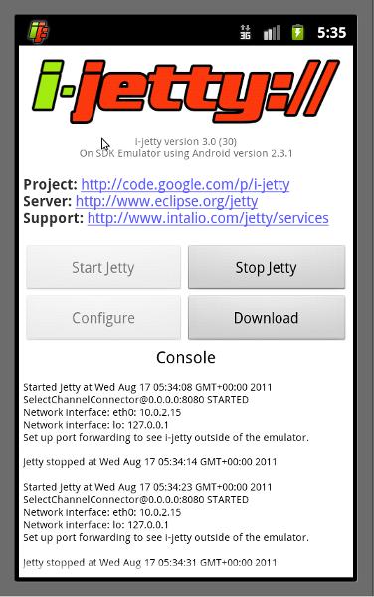
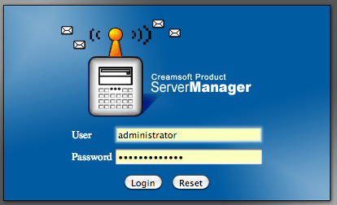
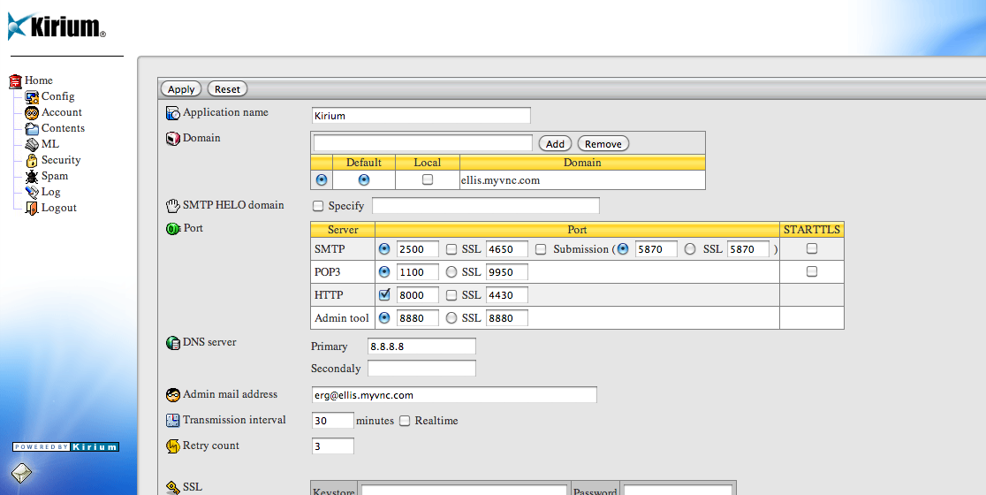
Backup

Slide 43

Demo Network Architecture
VPN
Cellular
Network
http://clay.elec529.recg.rice.edu:8080/
http://adriana.elec529.recg.rice.edu:8080/
http://ellis.elec529.recg.rice.edu:8080/
Dr. Ng

Slide 44

Related Work – P2P
BitCoin
Open-source P2P money / payment system.
Low transaction cost, less risky, secure, etc.

